Slide 1

Financial Accounting
Jahangir Tanveer
Lecture 1

Slide 2
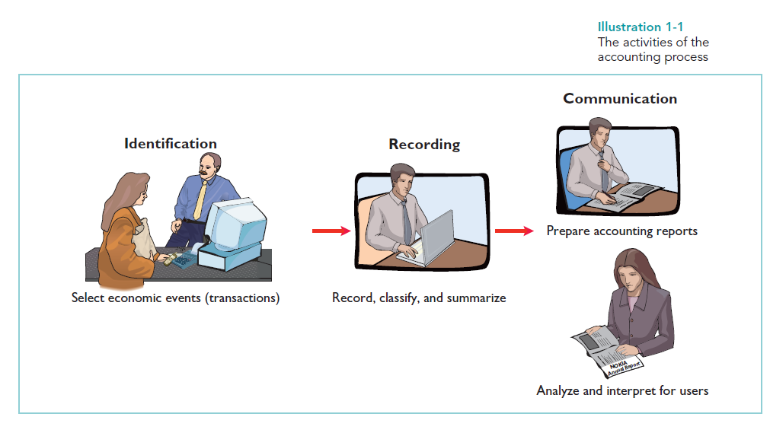
Accounting Process

Slide 3
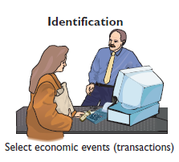
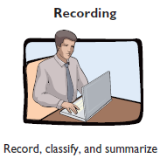
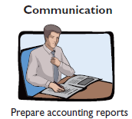
Accounting Process
To identify economic events, a company selects the economic events relevant to its business.
Recording consists of keeping a systematic, chronological diary of events, measured in dollars and cents.
Finally, the firm communicates the collected information to interested users by means of accounting reports.

Slide 4

Book Keeping & Accounting
Bookkeeping usually involves only the recording of economic events. It is therefore just one part of the accounting process. In total, accounting involves the entire process of identifying, recording, and communicating economic events.

Slide 5
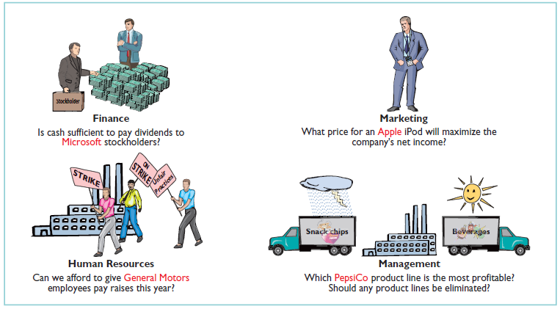
Users of Accounting Data Internal Users

Slide 6
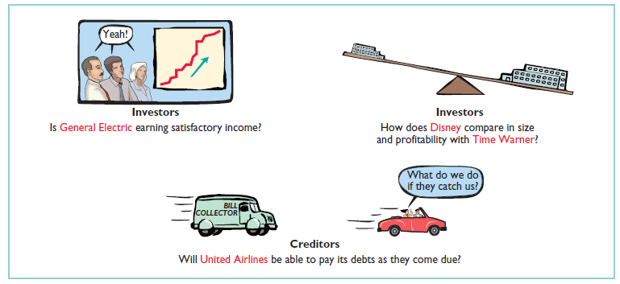
Users of Accounting Data External Users

Slide 7
Basic Accounting Equation
Assets= Liabilities + Owner’s Equity
Assets
As noted above, assets are resources a business owns.
Liabilities
Liabilities are claims against assets—that is, existing debts and obligations.
Owner’s Equity
The ownership claim on total assets is owner’s equity. It is equal to total assets minus total liabilities.

Slide 8
INCREASES IN OWNER’S EQUITY
Investments by Owner. Investments by owner are the assets the owner puts into the business. These investments increase owner’s equity. They are recorded in a category called owner’s capital.
Revenues. Revenues are the gross increase in owner’s equity resulting from business activities entered into for the purpose of earning income.

Slide 9
DECREASES IN OWNER’S EQUITY
Drawings. An owner may withdraw cash or other assets for personal use. We use a separate classification called drawings to determine the total withdrawals for each accounting period. Drawings decrease owner’s equity.
Expenses. Expenses are the cost of assets consumed or services used in the process of earning revenue. They are decreases in owner’s equity that result from operating the business.

Slide 10
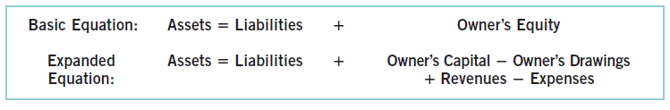
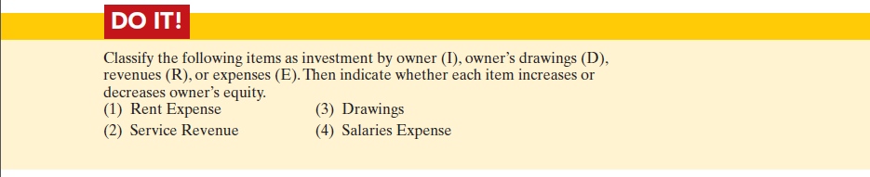
Expanded Accounting Equation

Slide 11
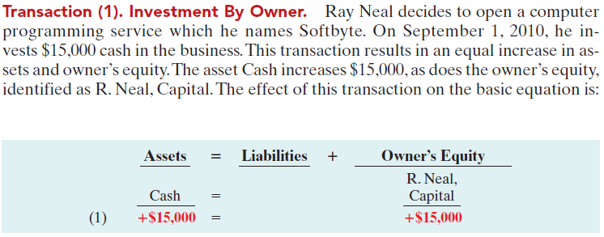
Transaction Analysis
The following examples are business transactions for a computer programming business during its first month of operations.

Slide 12
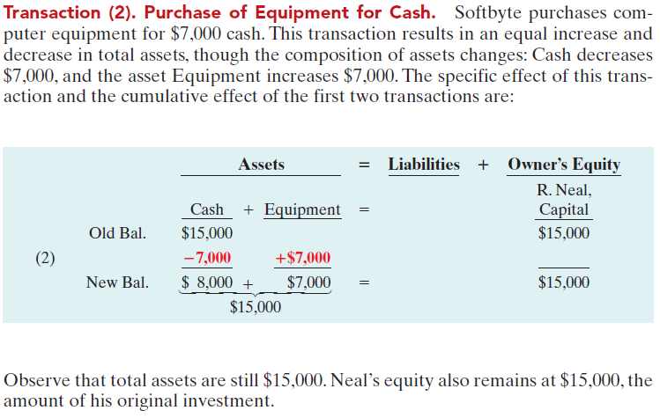
Transaction Analysis

Slide 13
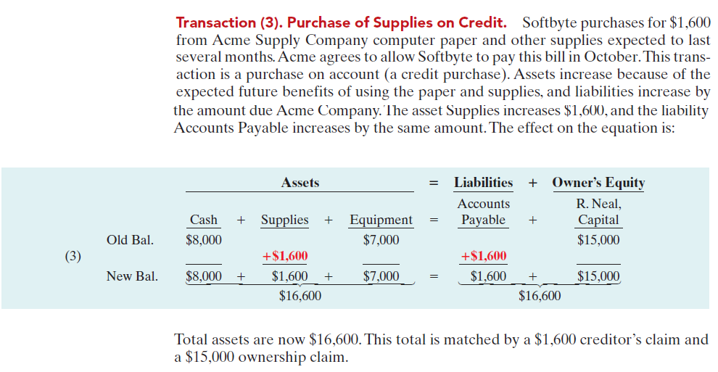
Transaction Analysis

Slide 14
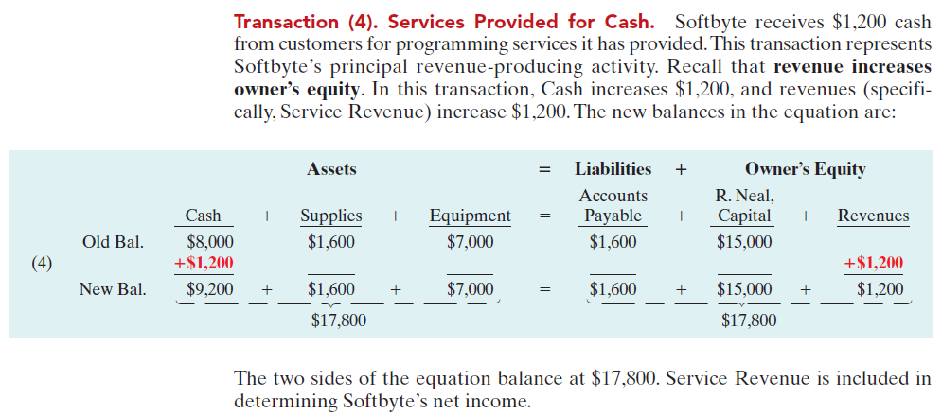
Transaction Analysis

Slide 15
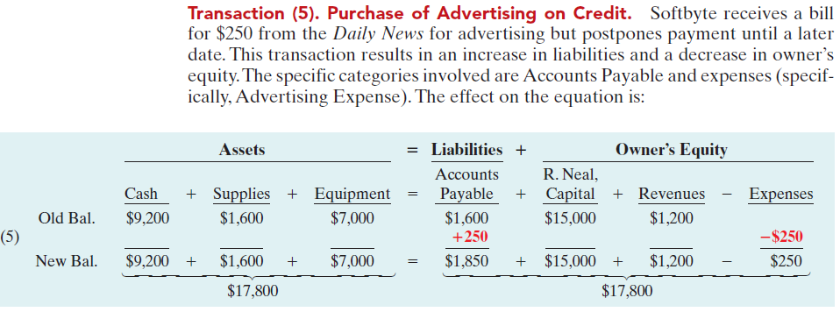
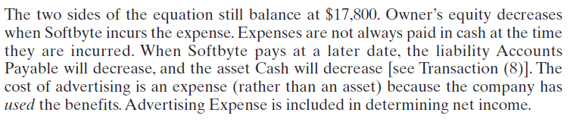
Transaction Analysis

Slide 16
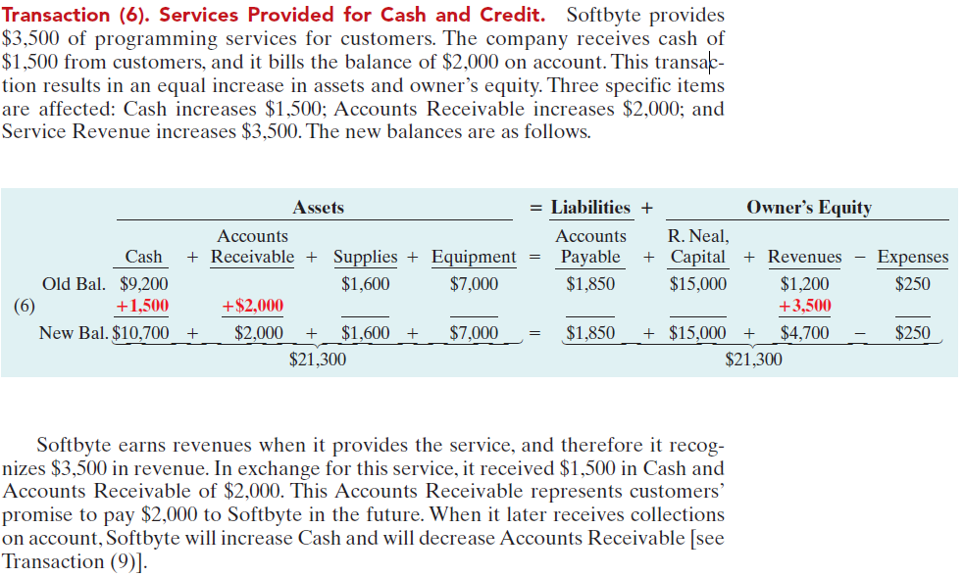
Transaction Analysis

Slide 17
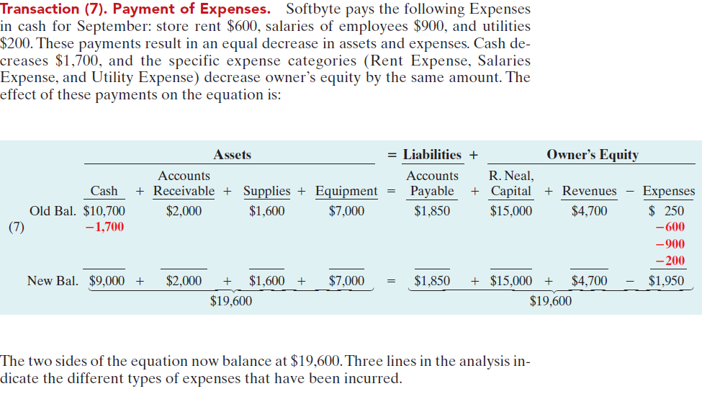
Transaction Analysis

Slide 18
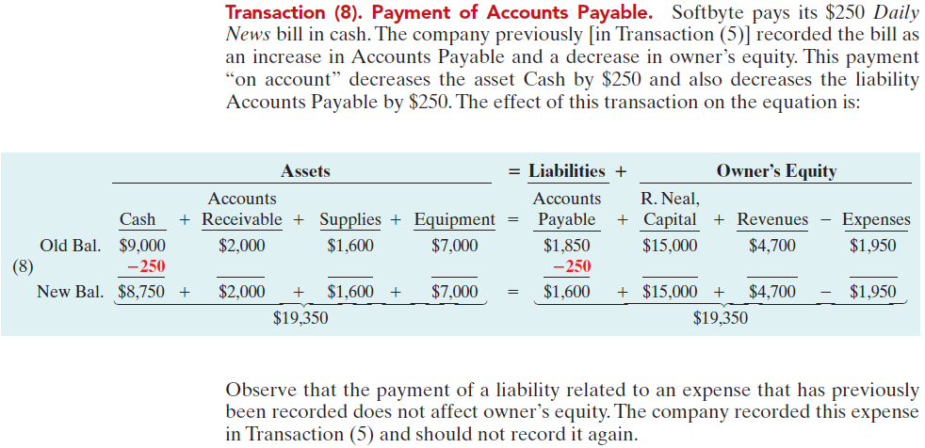
Transaction Analysis

Slide 19
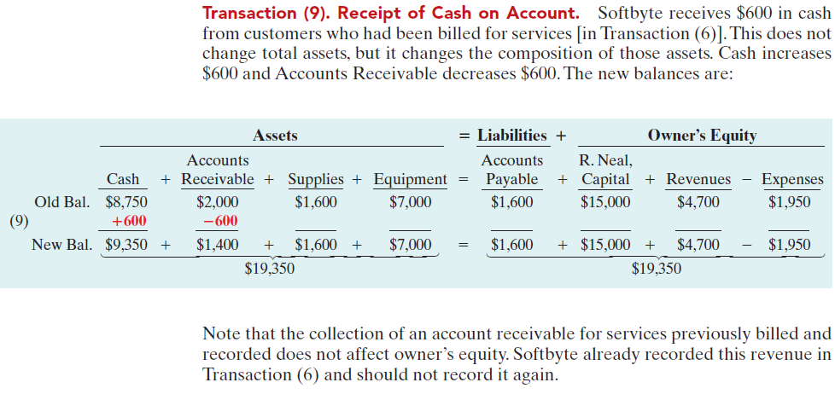
Transaction Analysis

Slide 20
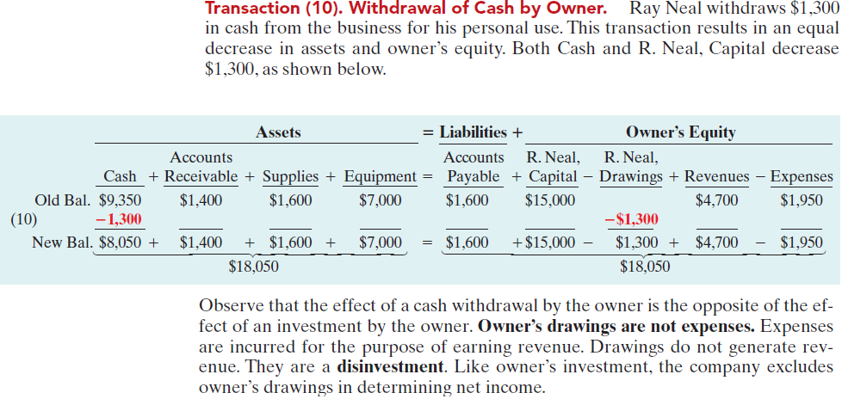
Transaction Analysis

Slide 21
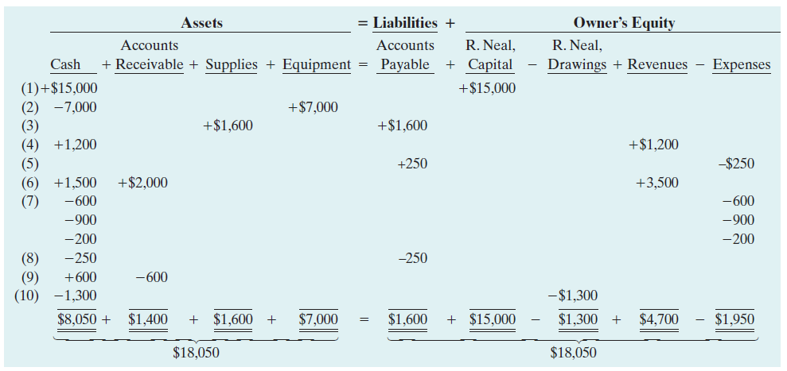
Summary of Transactions

Slide 22
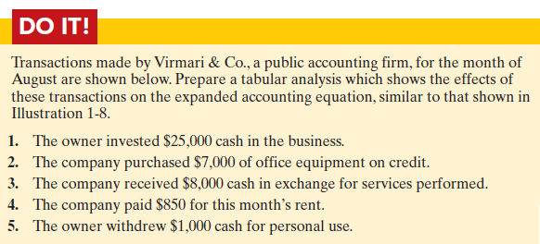

Slide 23
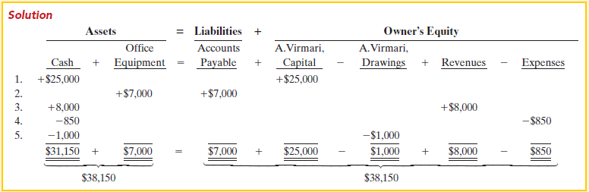

Slide 24
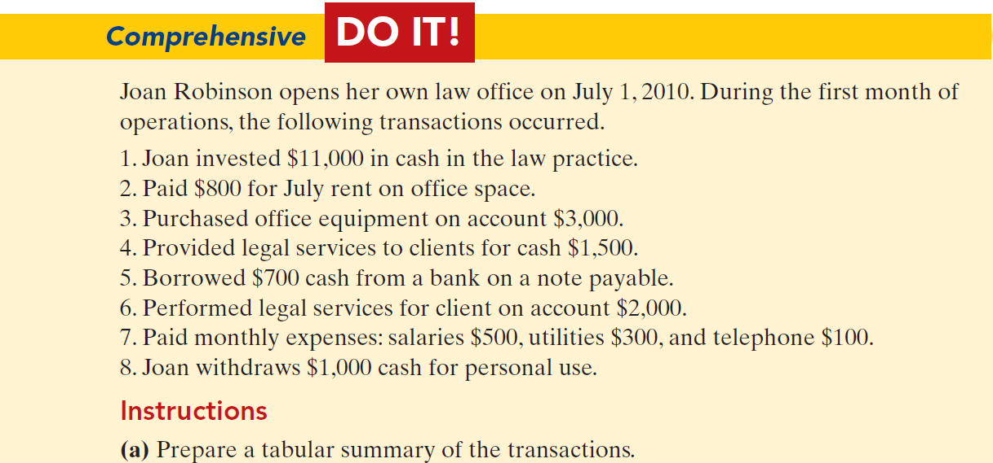

Slide 25
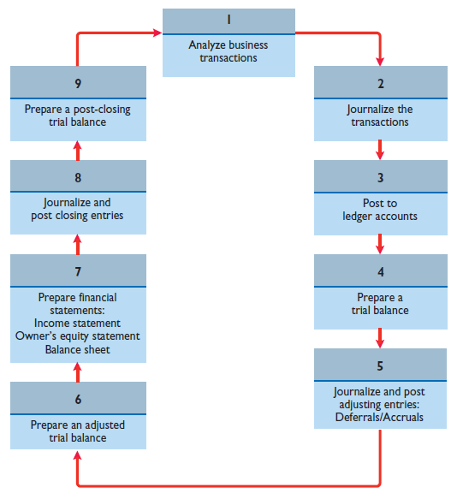
Accounting Cycle

Slide 26
Types of Accounts
Increase Decrease
Assets Debit Credit
Liabilities Credit Debit
Capital Credit Debit
Revenue Credit Debit
Expenses Debit Credit

